Slide 1
Cool Beans
A Look at Chocolate Bar Ratings
Sophia Anderson, Ariel Todoki

Slide 2
Data Overview
Kaggle dataset
Compiled reviews from FlavorsofCacao.com
All done by Brady Brelinski, co-author of site
Founding Member of the Manhattan Chocolate Society
Focused on Dark Chocolate
Each row represents one bar from one batch

Slide 3
Bar Criteria
Flavors of Cacao Rating System:
5= Elite (Transcending beyond the ordinary limits)
4= Premium (Superior flavor development, character and style)
3= Satisfactory (3.0) to praiseworthy(3.75) (well made with special qualities)
2= Disappointing (Passable but contains at least one significant flaw)
1= Unpleasant (mostly unpalatable)
(FlavorsofCacao.com)

Slide 4
IT’S COMPLICATED
(and pretty subjective)
Each chocolate is evaluated from a combination of both objective qualities and subjective interpretation. A rating here only represents an experience with one bar from one batch. Batch numbers, vintages and review dates are included in the database when known.
Flavor is the most important component of the Flavors of Cacao ratings. Diversity, balance, intensity and purity of flavors are all considered. It is possible for a straight forward single note chocolate to rate as high as a complex flavor profile that changes throughout. Genetics, terroir, post harvest techniques, processing and storage can all be discussed when considering the flavor component. Texture has a great impact on the overall experience and it is also possible for texture related issues to impact flavor. It is a good way to evaluate the makers vision, attention to detail and level of proficiency. Aftermelt is the experience after the chocolate has melted. Higher quality chocolate will linger and be long lasting and enjoyable. Since the aftermelt is the last impression you get from the chocolate, it receives equal importance in the overall rating. Overall Opinion is really where the ratings reflect a subjective opinion. Ideally it is my evaluation of whether or not the components above worked together and an opinion on the flavor development, character and style.

Slide 5
Our Questions
Are the ratings consistent enough for us to predict a bar’s rating based on a few characteristics?
Is a chocolate’s rating consistent with the bean type?
Are certain varieties of bean better than others?
Is a bar’s rating based more on the variety of bean or the company making the bar?
Is there a relationship between cocoa solids percentage and rating?

Slide 6
Initial Observations
Only two good numeric values to work with
The rest are names and therefore read as objects
Website did not clarify about how they defined REF
Review year wouldn’t change the rating of the chocolates
As of early 2017, only one chocolate bar was given a 5
(Were we thinking about buying it? Maybe... )
Equatorial growing locations
Most bars have around 70% cacao content

Slide 7
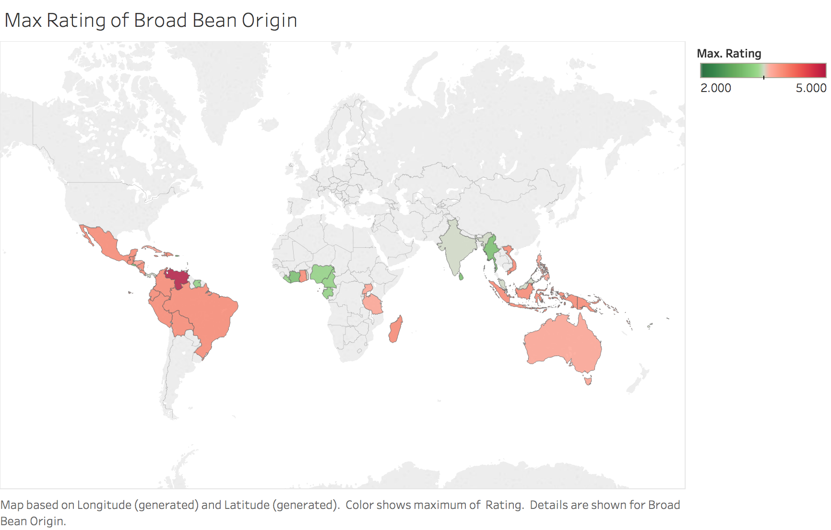
Broad Bean Origin Map
Venezuela broad bean origin has max rating of 5
Beans grow in equatorial regions

Slide 8
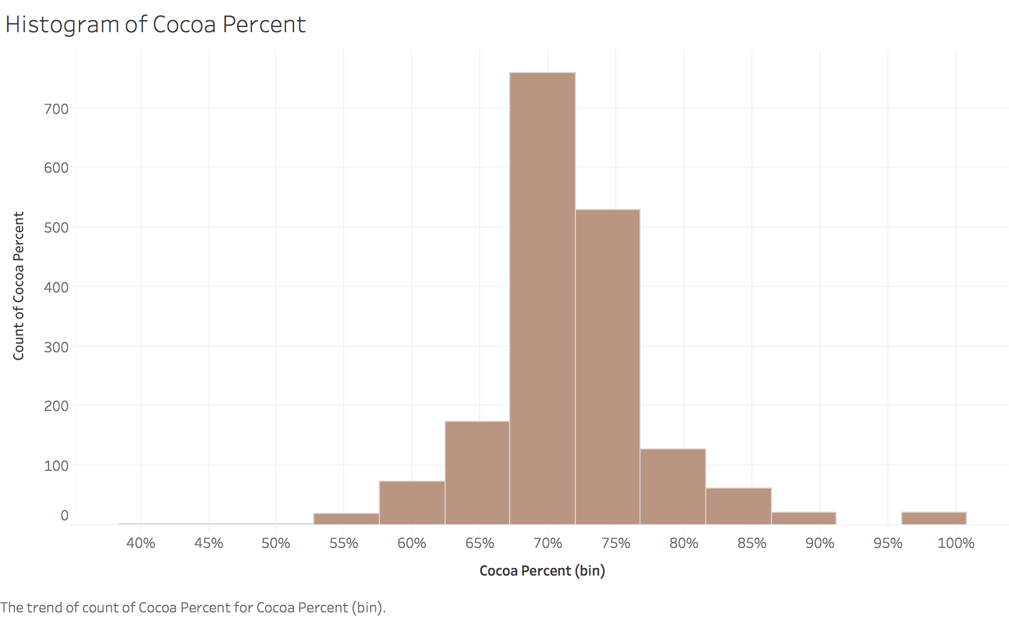
Exploratory Data Analysis
Most of the chocolate in our data has a cocoa percent between 70% - 75%

Slide 9
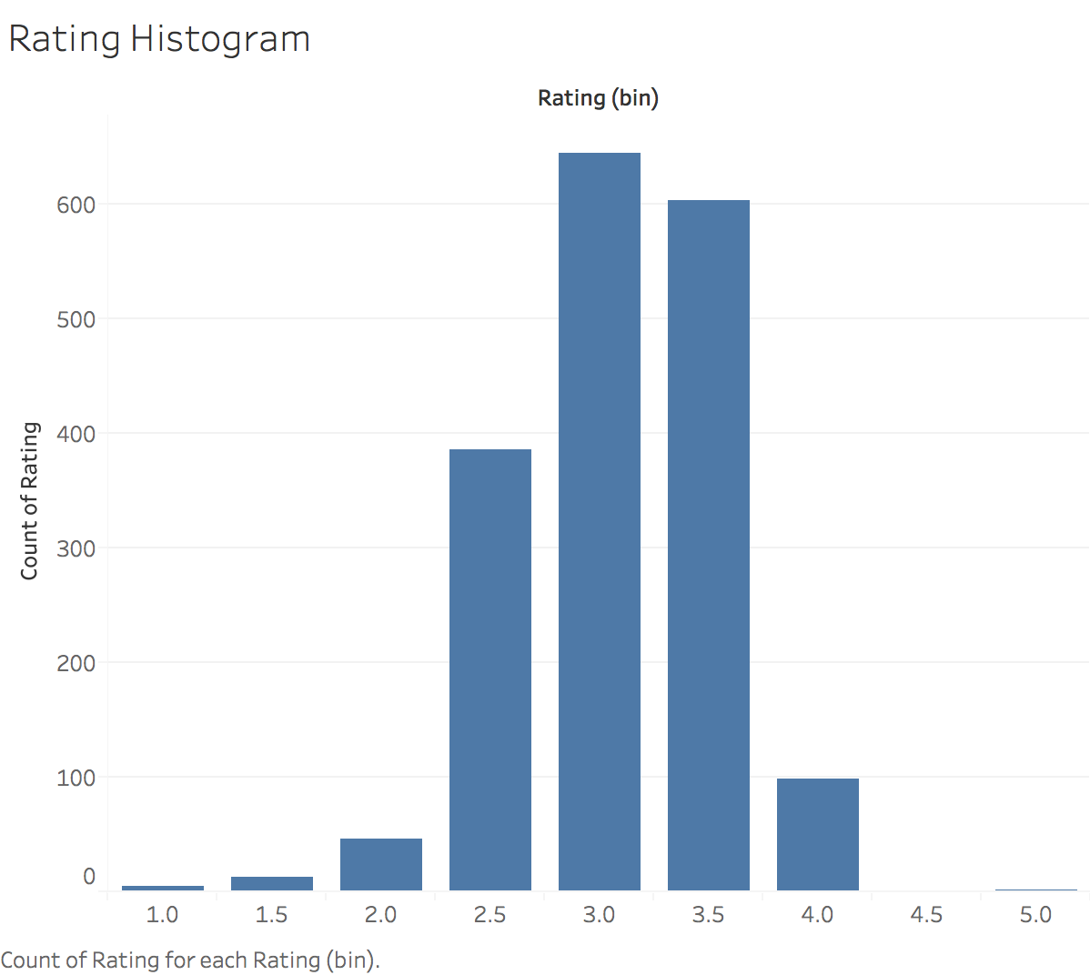
EDA (cont.)
Most of the ratings given to the chocolate in our data is between 3.0 and 3.5

Slide 10
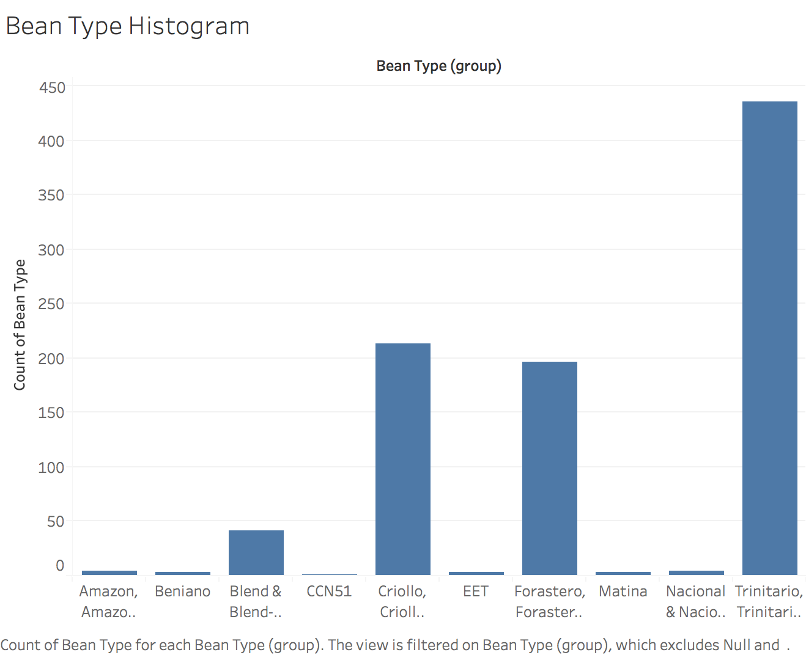
EDA (cont.)
Grouped by bean type
Criollo, Forastero, and Trinitario are the most commonly used bean varieties
(Each have a different general use in the chocolate production industry)

Slide 11
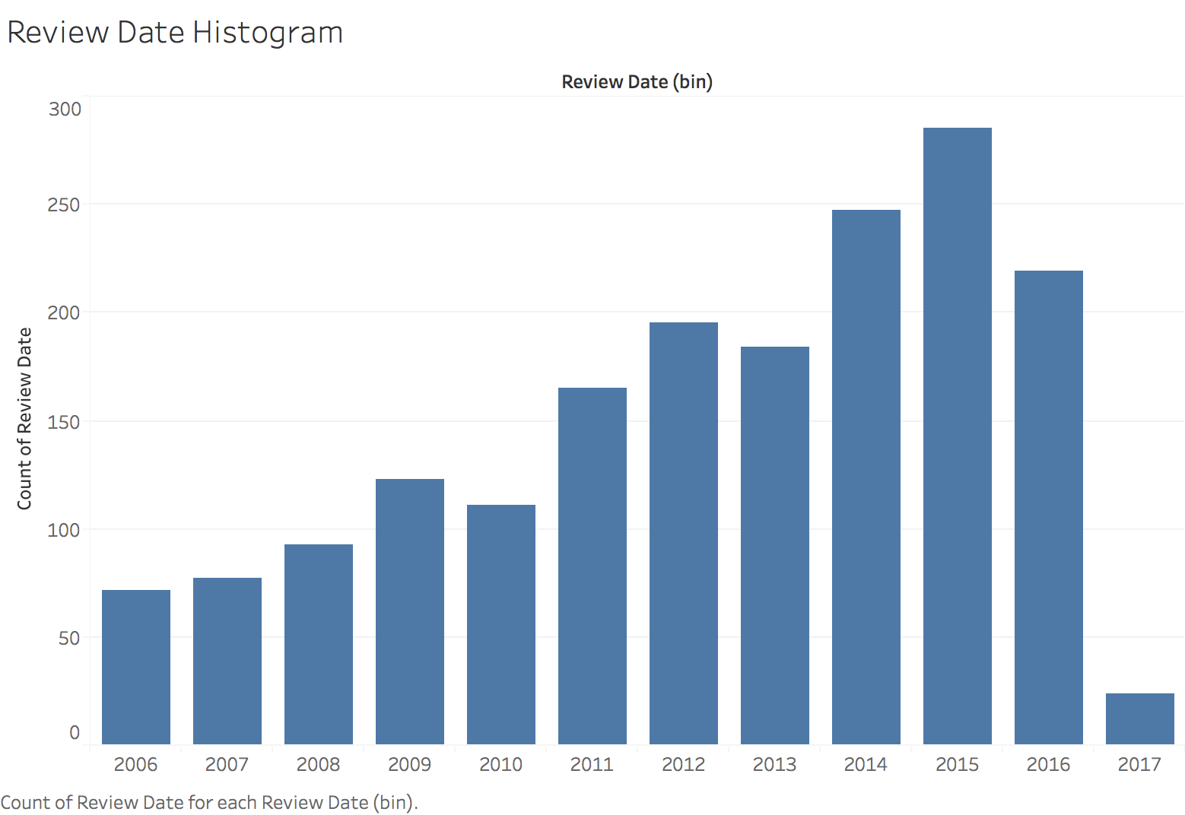
EDA (cont.)
2015 had the most number of reviews
Overall trend seems to be an increasing amount of reviews
Our data set was compiled in 2017, therefore not including all reviews made in 2017

Slide 12
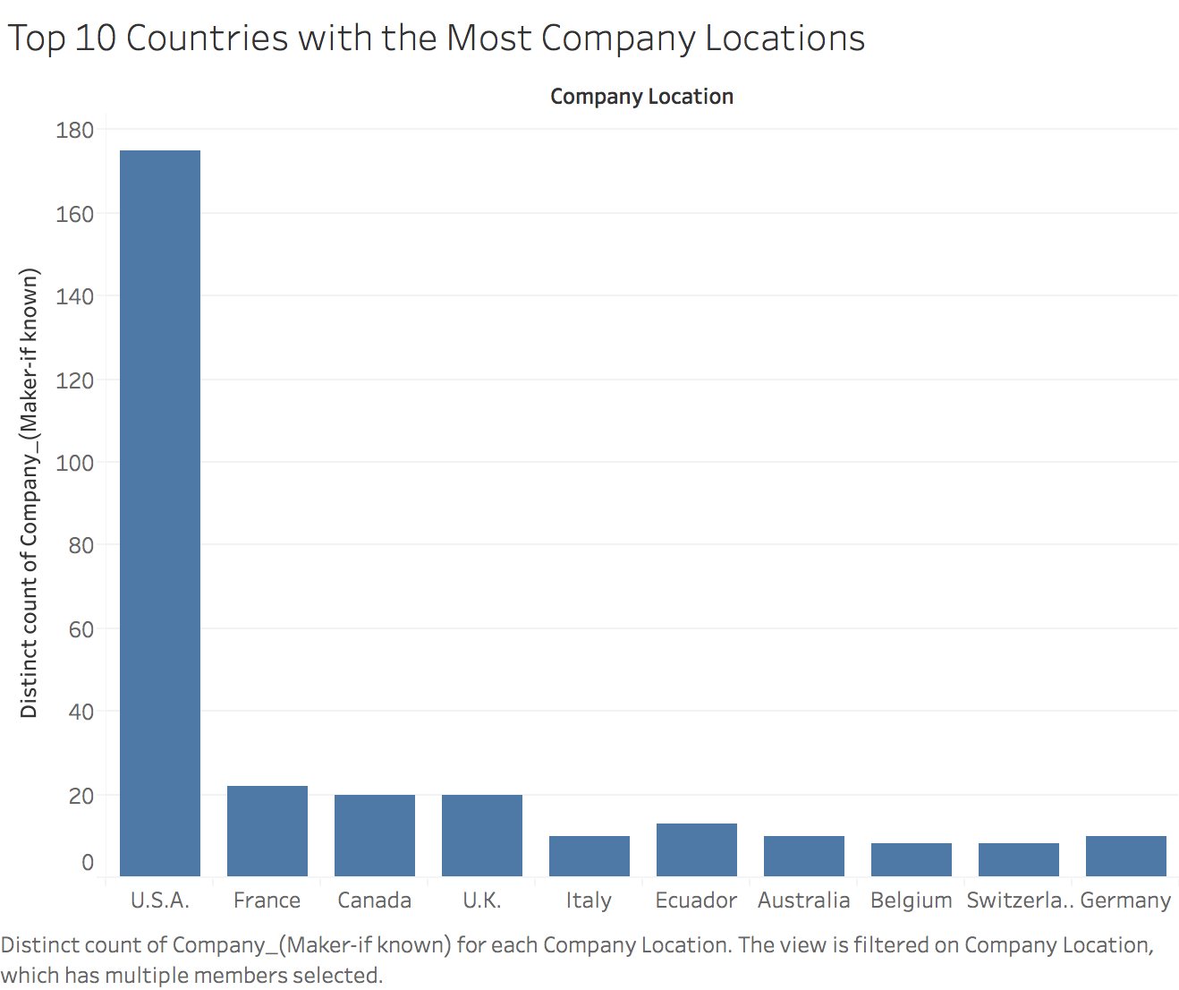
EDA (cont.)
Grouped by distinct company names, then by company locations
U.S.A. has the most number of chocolate companies, followed by France, Canada, and the U.K.

Slide 13
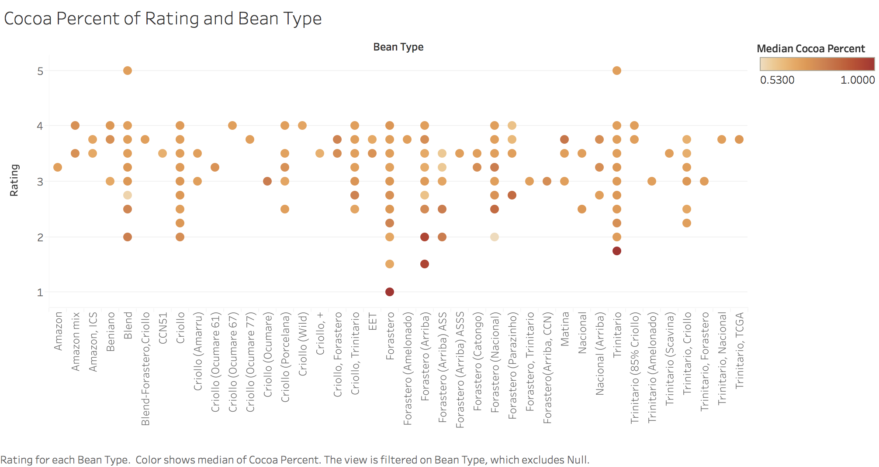
EDA (cont.)
Higher percentage of cocoa seems to get lower ratings

Slide 14
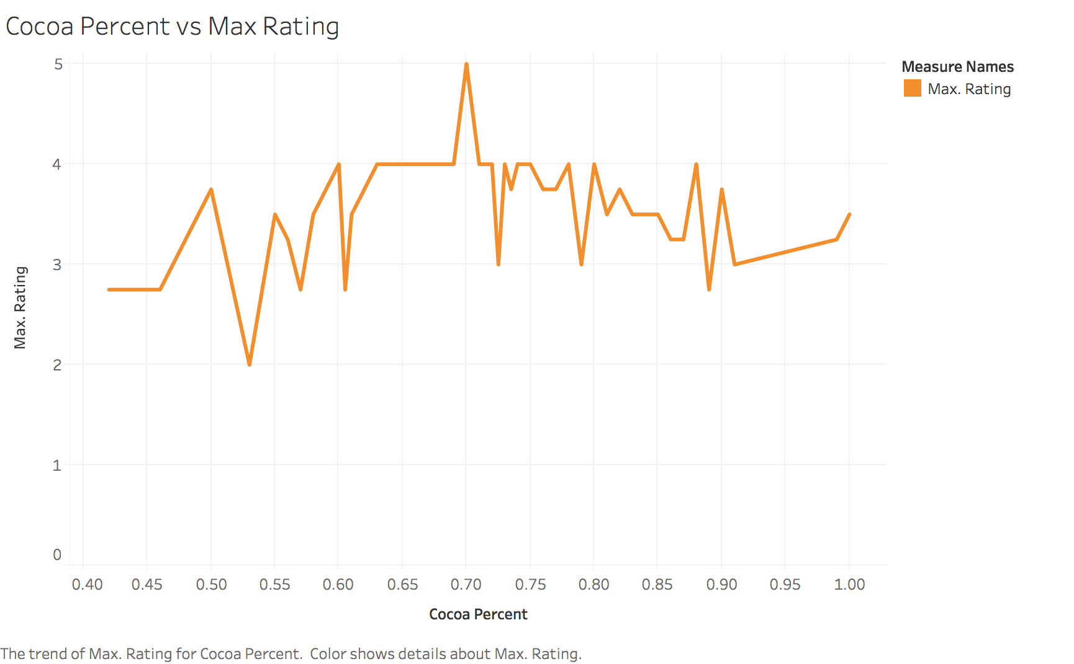
EDA (cont.)
Max Ratings from each cocoa percent
70% cocoa has the highest max rating of 5

Slide 15
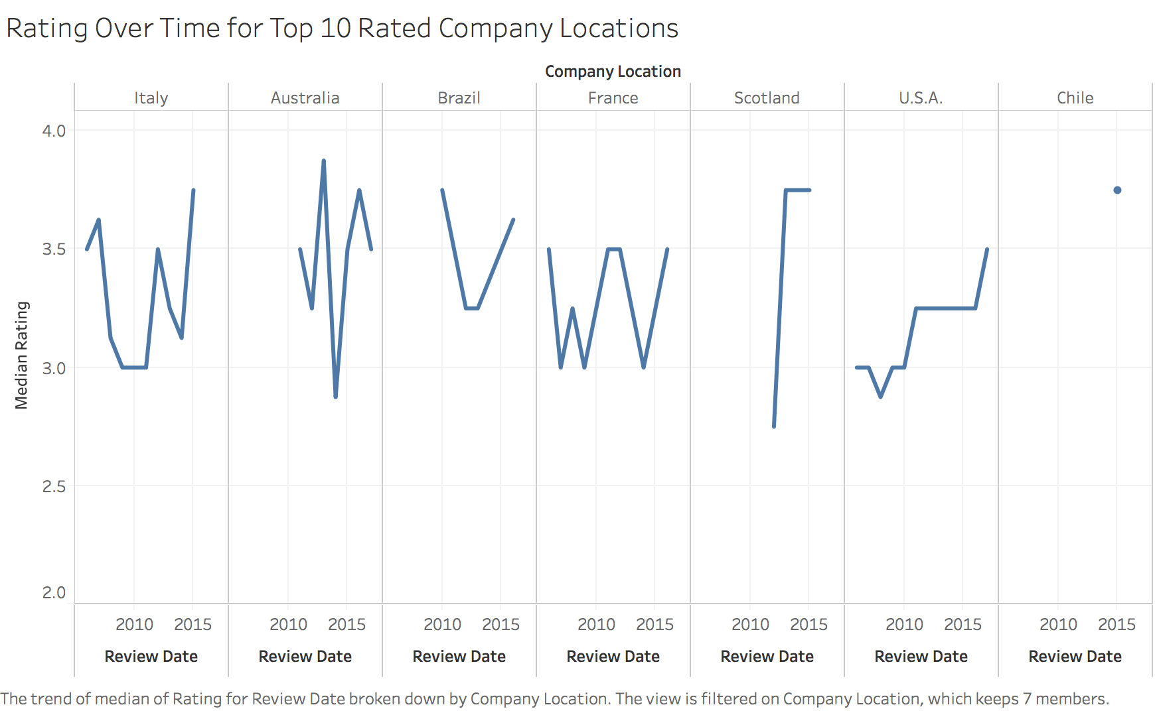
EDA (cont.)
Scotland and U.S.A. median rating seems to increase over the years

Slide 16
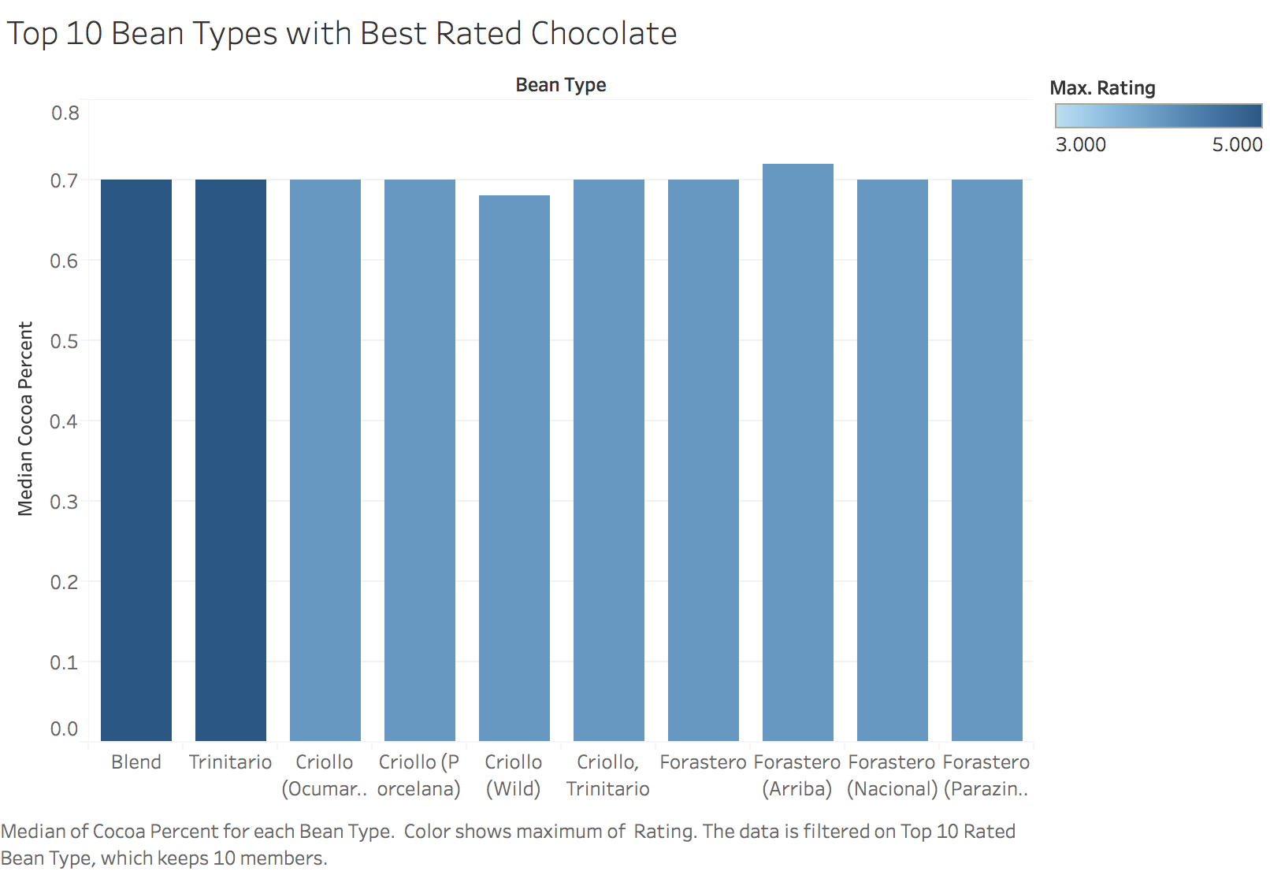
EDA (cont.)
Blend and Trinitario have the highest max rating of 5
Criollo and Forastero have the next highest max rating of 4
Forastero is used for bulk chocolate making
Forastero (Arriba) and Forastero (Nacional) are considered fine flavor cocoa

Slide 17
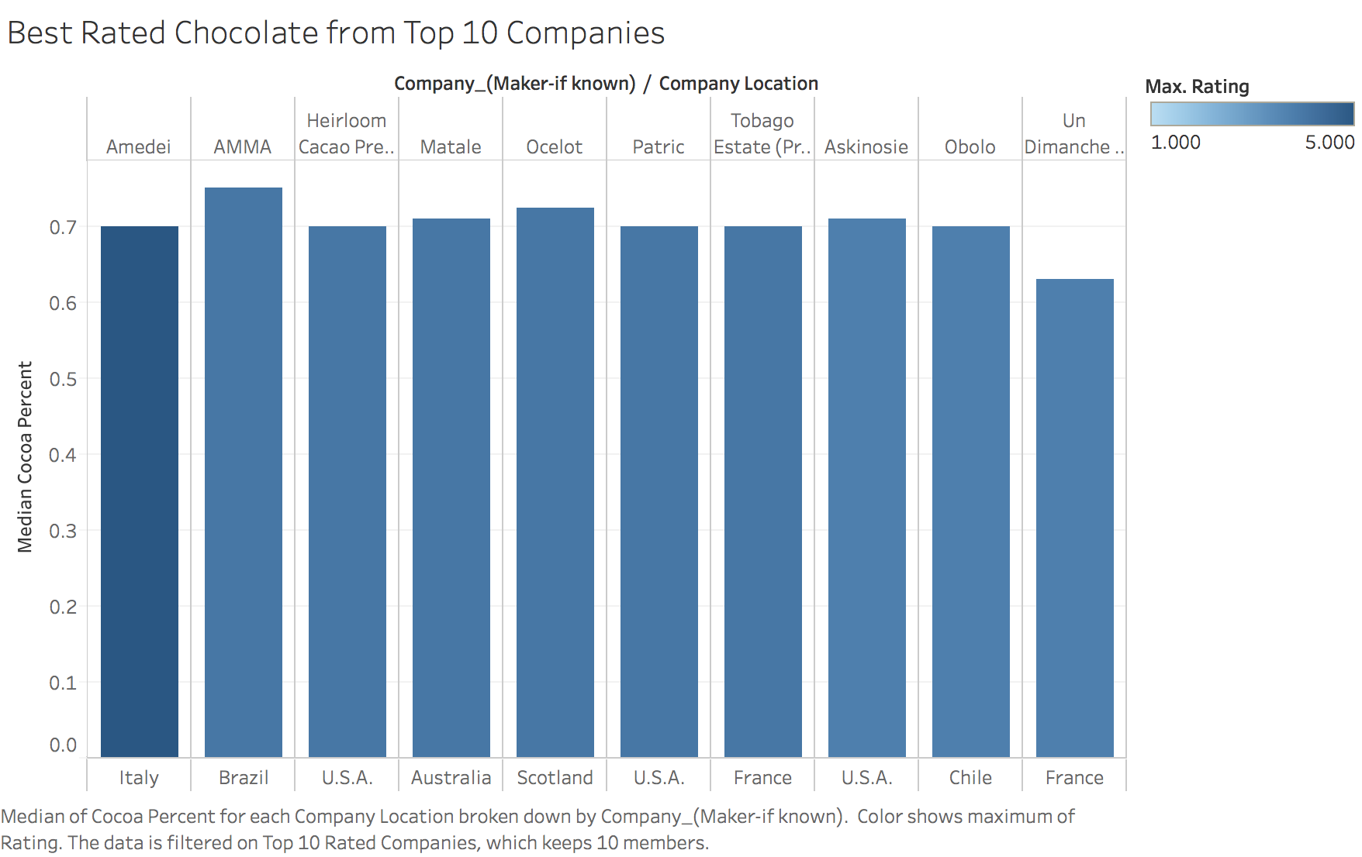
EDA (cont.)
Amedei in Italy has the highest max rating of a 5 with median cocoa percent at 70%

Slide 18
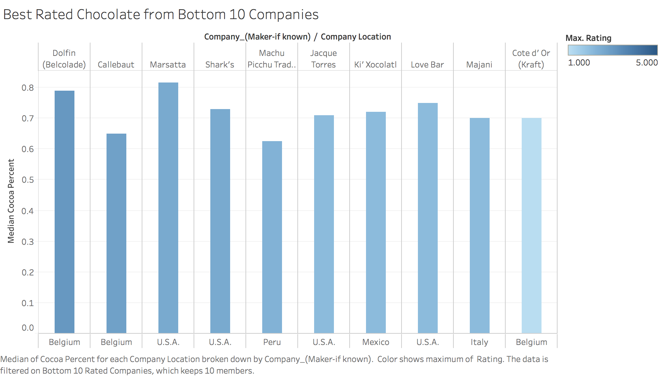
EDA (cont.)
Cote d’ Or (Kraft) in Belgium has the lowest max rating of a 1

Slide 19
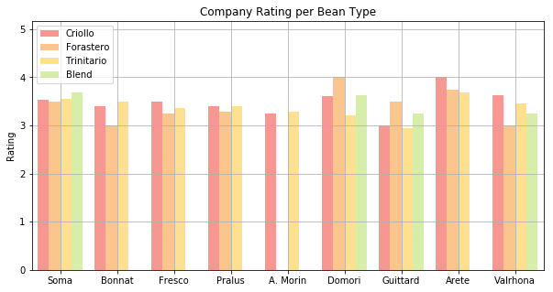
Company Profiles
Top 10 companies with the most chocolate bars in the dataset
Forastero has lowest rating for most companies unless Forastero (Arriba) or Forastero (Nacional) was used, which are considered fine flavor cocoa

Slide 20
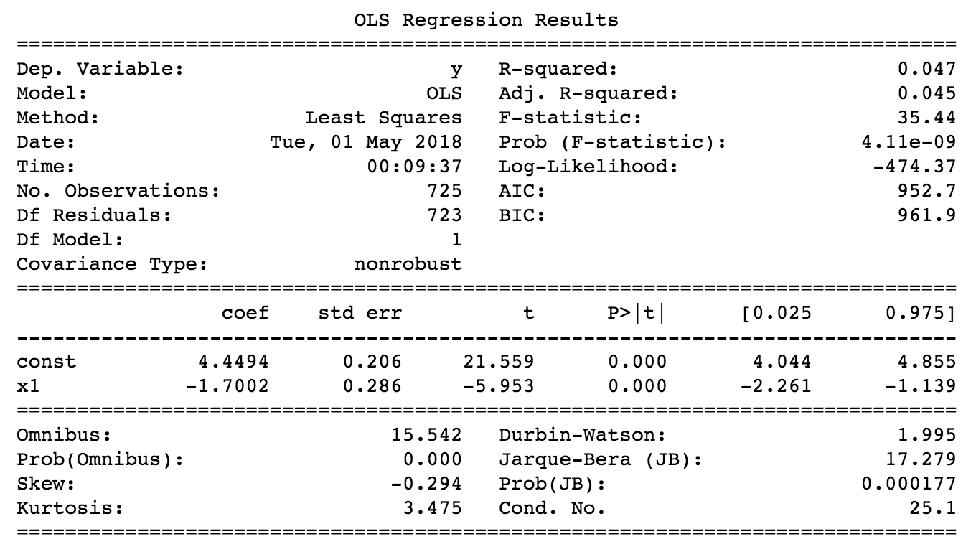
Linear Regression
R-squared value: 0.047
5% of the model explains the variability of the response data

Slide 21
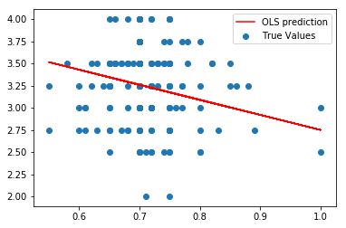
Linear Regression (cont.)
Test set
Does not seem like linear regression model is the best fit for our data

Slide 22
KNN Modeling (attempt)
Predict bean type
Each bean has a general reputation within the cacao community
KNN model with percentage of cacao and rating
Used K value of 23
Separated into 20% test set, 80% training set
Confusion Matrix:
Bean Type | Precision | Recall
Criollo | 0.27 | 0.14
Forastero | 0.29 | 0.05
Other | 0.0 | 0.0
Trinitario | 0.49 | 0.84
6 | 3 | 0 | 33
4 | 2 | 0 | 35
0 | 0 | 0 | 10
12 | 2 | 0 | 75

Slide 23
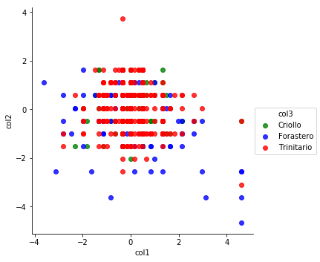
KNN Modeling (cont.)
Training Set

Slide 24
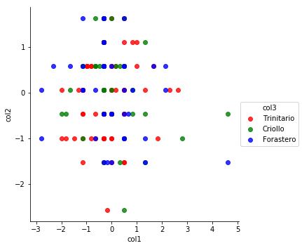

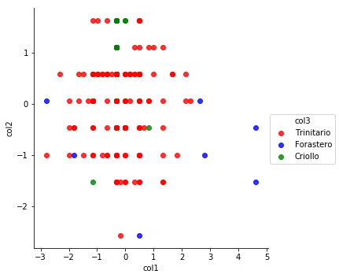
KNN Modeling (cont.)
Test Set (Correct Categorization)
Test Set (Predicted Categorization)

Slide 25
Conclusions
Bean types which are blends seem to have the highest ratings
Blend and Trinitario (which is a blend of Criollo and Forastero) bean types received the highest ratings
Forastero bean type receives the lowest ratings when compared with other chocolate made with other bean types within the same company
70% cocoa tends to have higher ratings, 100% cocoa has lower ratings
A linear regression model and K-nn model did not perform well to predict chocolate rating or classification of bean type

Slide 26
Challenges
Ratings are very subjective, even if compiled by one person
1,500 may sound like a decent amount of data points to work with, but get reduced quickly
Missing data
Small chunks after sorted into different companies
Latitude and Longitude
Not very accurate
Didn’t end up working

